Slide 1
Crop Science
Lecture 1
28th May 2023

Slide 2
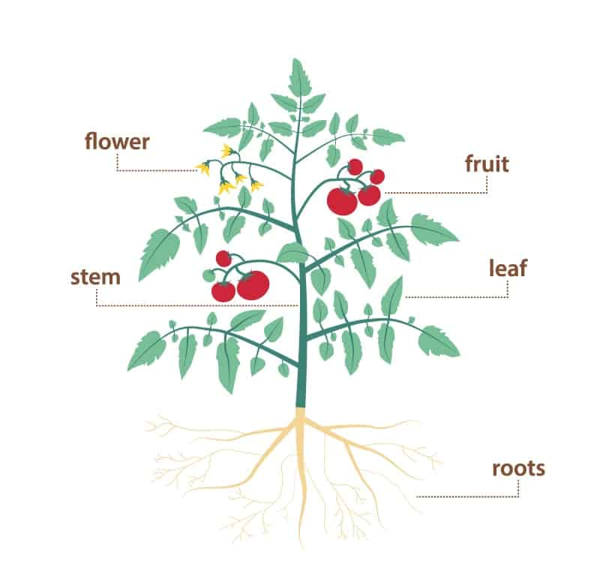
The Plant

Slide 3
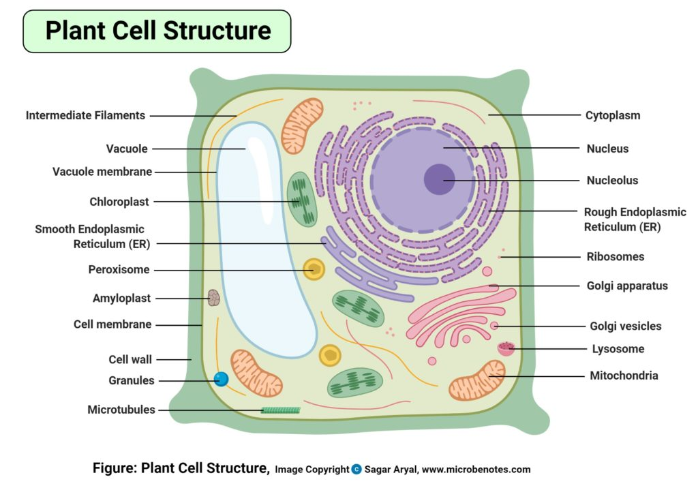
Plant cells
Store room/chamber – basic building blocks of plant structure
Cell wall- primary and secondary
Nucleus – genetic material of cell
Endoplasmic reticulum- network of internal membranes
Golgi bodies- synthesis and secretion
Central vacuole- water/solutes site
Mitochondria/Chloroplast- energy conversion site

Slide 4
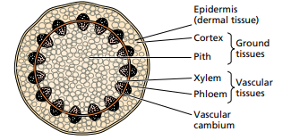
Plant tissuess
Dermal
Ground
Vascular
Tissues contains a variety of cell types specialized for different functions

Slide 5
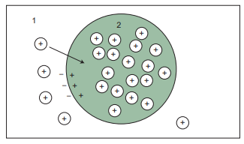
Energy
Energy is the capacity to do work
Total energy absorbed by leaf = energy emitted from leaf + energy stored by leaf
Movement of charged solute (from compartment 1 to compartment 2) must do work to overcome both the electrochemical-potential gradient and the concentration gradient.
Cations in compartment 2 have been raised to a higher electrochemical potential

Slide 6
Enzymes
Enzymes : catalysts of life, in control of almost all life processes
Proteins in metabolism serve as enzymes
Catalysts to increase rate of biochemical reactions
Control all life processes
Thousands of enzymes in a cell
Work on specific substrates, ambient temperature and pressure

Slide 7
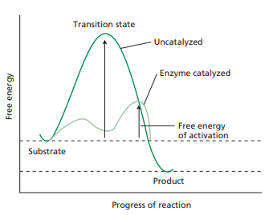
Enzymes
Enzymes Lower free energy barrier of substrate and product

Slide 8
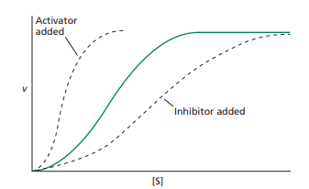
Enzyme inhibitors and activators
Inhibitor – agent reducing the velocity of an enzyme catalysed reaction.
Activator – agent increasing velocity of an enzyme catalysed reaction.
Used to regulate enzyme activities in cells
Fructose bisphosphate regulate carbon metabolism in plants

Slide 9
Water qualities
Water makes up 80-95% of plant cells mass
Important solvent due to small size and polar nature
Cohesion – attraction between water molecules
Adhesion – attraction to cell walls or glass surface

Slide 10
Plants water balance
Atmosphere is the source of CO₂ but relatively dry and needs water from the plant
Contact of root surface and soil basis for water absorption
Xylem tissue – tube that moves water from the roots to leaves
Cavitation is appearance of bubbles that disrupt the continuum of water flow
Water movement from leaf to atmosphere through stomata pores
Driving force is the difference in water vapour concentration of leaf/atmosphere

Slide 11
Mineral Nutrients
Mineral nutrition – study of how plants obtain and use mineral nutrients
Essential elements – absence prevents a plant to complete life cycle
Relative concentration in plants define micro/macro nutrients
Fertilizer additions improve crop yields
Straight fertilizers contain a single nutrient e.g super phosphate, ammonium nitrate and potash
Compound fertilizers contain more than one nutrient

Slide 12
Fertilizer application
Foliar application is fertilizer application to a plant through leaves
Advantages
Reduce lag time of application and uptake
Avoid leaching of nutrients in the soil
Disadvantages
Leaf scorching
Addition of additive required for efficiency

Slide 13
Nutrient availability
Decomposition of minerals by weathering, followed by leaching of cations, such as K, Ca, and Mg by rain
Plant-induced production of acidity, when an excess of cations over anions is taken up eg N2 or NH4 , rather than NO3 — , is used as N source for plant growth
Soils may also acidify due to human activities such as input of nitric and sulfuric acids or the addition of acidic fertilizer, such as ammonium sulfate or urea
pH affects the availability of nutrients to the plant
Favourable pH for nutrient availability 5.5- 6.5
Mycorrhizal fungi improve the surface area of roots for nutrient absorption

Slide 14
Solute transport
Transport is the movement of molecules and ions from one location to another
Plants exchange solutes with the environment and within tissues and organs
Transport of solutes down a chemical gradient is passive transport

Slide 15
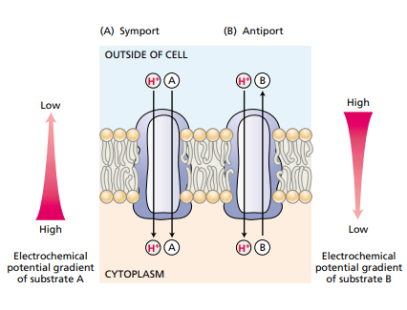
Active transport
Movement of solutes against a chemical potential gradient is active transport and require energy input
symport, the energy dissipated by a proton moving back into the cell is coupled to the uptake of one molecule of a substrate
Antiport, the energy dissipated by a proton moving back into the cell is coupled to the active transport of a substrate
The substrate moving against its gradient of electrochemical potential

Slide 16
Fertilizer Application
Maize
Top dressing 150kg per hectare
0.3m X 0.75m = 0.225m2
150kg – 10000m2
X – 0.225m2
0.003375kg
3.375g

Slide 17
Maize basal dressing 200kg per hectare
0.3m X 0.75m = 0.225m2
200kg – 10000m2
X – 0.225m2
0.0045kg
4.5g

